Slide 1
Outline
Storyline of current draft
Discussion of some other issues (not included in the draft)

Slide 2
Outline
Storyline of current draft
Discussion of some other issues (not included in the draft)

Slide 3
Section 2: Background (drafted)
Routing loops in DCNs:
In DCNs, routing loops can be caused by 1) Device failures; 2) Misconfigurations; 3) Corruption of TCAM table.
Discussion of two types of routing loops: persistent and transient.
Priority-based Flow Control in RoCEv2-based RDMA DCNs
A brief description of PFC mechanism.
The use of PFC will introduce two problems:
congestion spreading problem(well handled by DCQCN).
Loop-induced deadlock problem(the problem to be addressed in this paper).

Slide 4
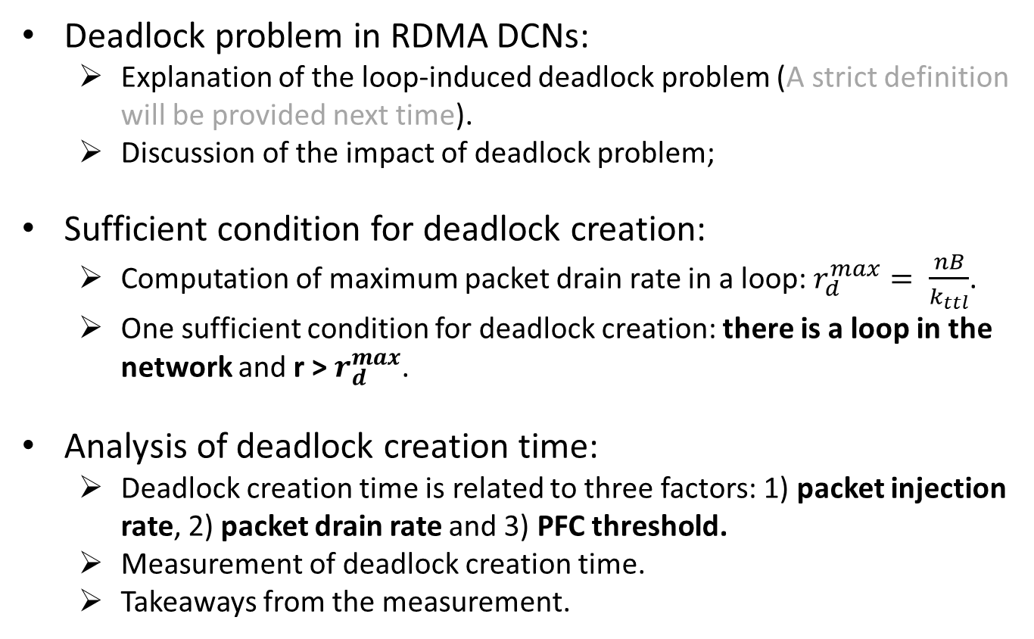
Section 3: Analysis of deadlock problem (drafted)
Deadlock problem in RDMA DCNs:
Explanation of the loop-induced deadlock problem (A strict definition will be provided next time).
Discussion of the impact of deadlock problem;
Sufficient condition for deadlock creation:
Computation of maximum packet drain rate in a loop: $r_{d}^{max}= \frac{nB}{k_{ttl}}$.
One sufficient condition for deadlock creation: there is a loop in the network and r > $r_{d}^{max}$.
Analysis of deadlock creation time:
Deadlock creation time is related to three factors: 1) packet injection rate, 2) packet drain rate and 3) PFC threshold.
Measurement of deadlock creation time.
Takeaways from the measurement.

Slide 5
Section 4: Solution (not drafted yet)
Design goals:
Accurate detection of deadlock problem;
Fast reaction to deadlock problem;
Resolve deadlock problem at minimum cost (e.g., only one switch drop packets during the recovery process);
Help to troubleshoot the root causes behind the deadlock problem.
Drawbacks of distributed solutions:
Hard to achieved goals 1,3,4.
Timeout-based mechanism is not supported by many commodity switches.
Design of a centralized solution (still work on the details):
Leverage Pingmesh to detect potential deadlock problems: many hosts become unreachable within a short time;
Leverage Everflow to collect counter information from all the switches.
Analyze the global information and work out a solution to resolve the deadlock problem.

Slide 6
Outline
Storyline of current draft
Discussion of some other issues (not included in the draft)

Slide 7
Position of other problems
Mad NIC problem:
Hard to reproduce it in our testbed.
Can we position mad NIC as a one-hop deadlock problem?
General routing-induced deadlock problem:
In a Clos network, It requires at least two flows to traverse over non-shortest paths which is unlikely to happen in practice.
This problem has been well-studied in the past.

Slide 8
Backup: general routing-induced deadlock problem
Flow 2: S2 -> S3 -> S4
Flow 1: S1 -> S2 -> S3
S1
S2
S4
S3
Flow 3: S3 -> S4 -> S1
Flow 4: S4 -> S1 -> S2
Flow direction
PFC pause direction

